Slide 1
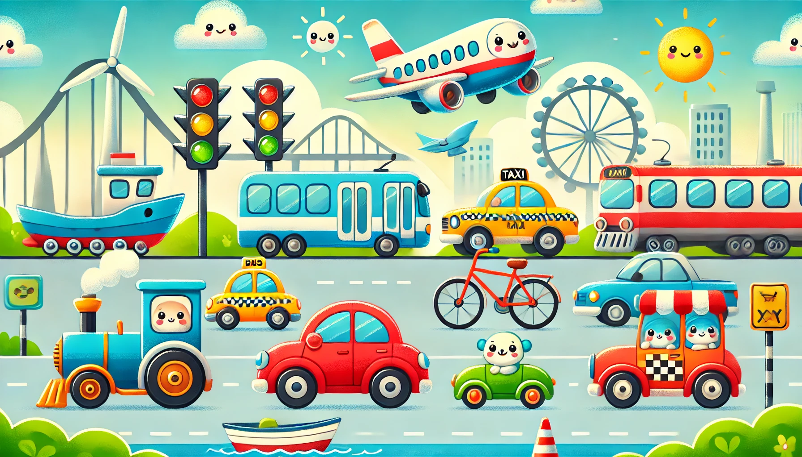
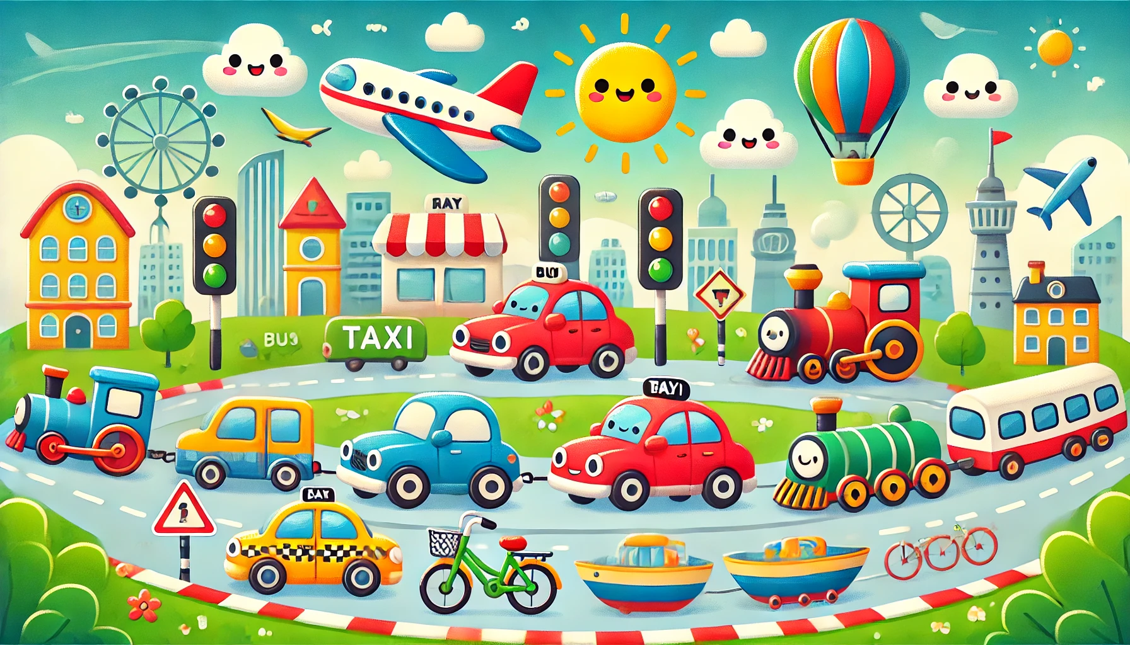
Little Riders
Coloring Book

Slide 2
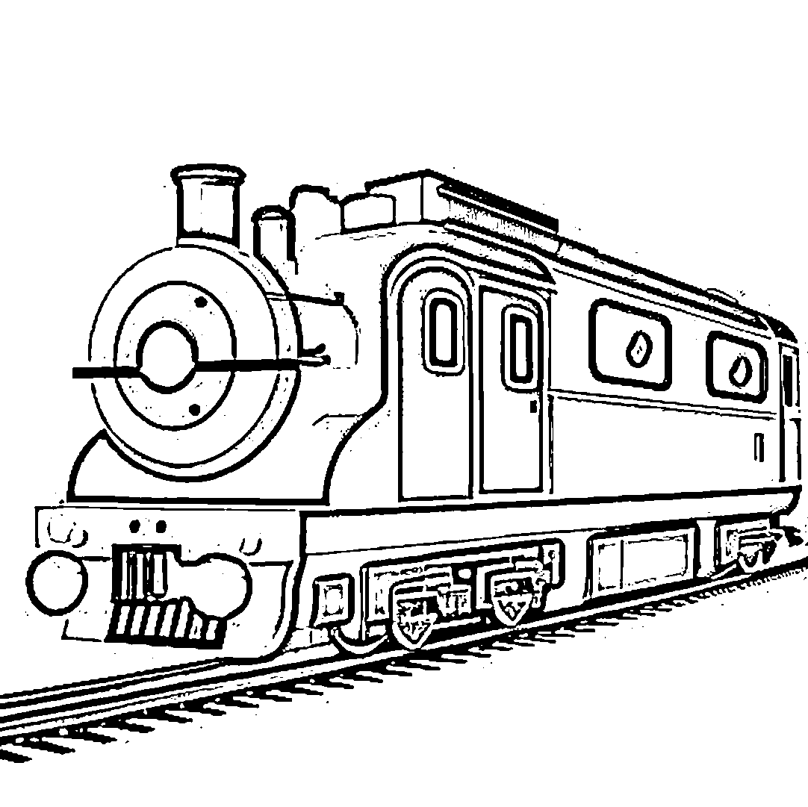
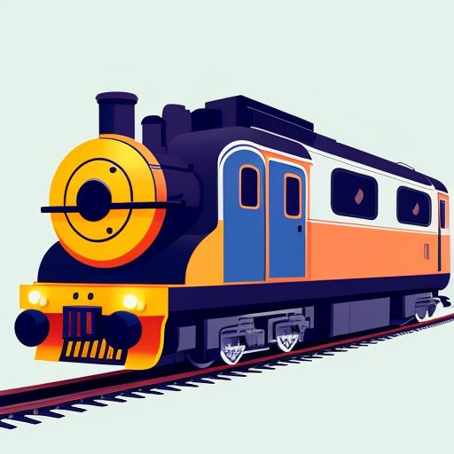
Trace & Color
Transportation
Train

Slide 3

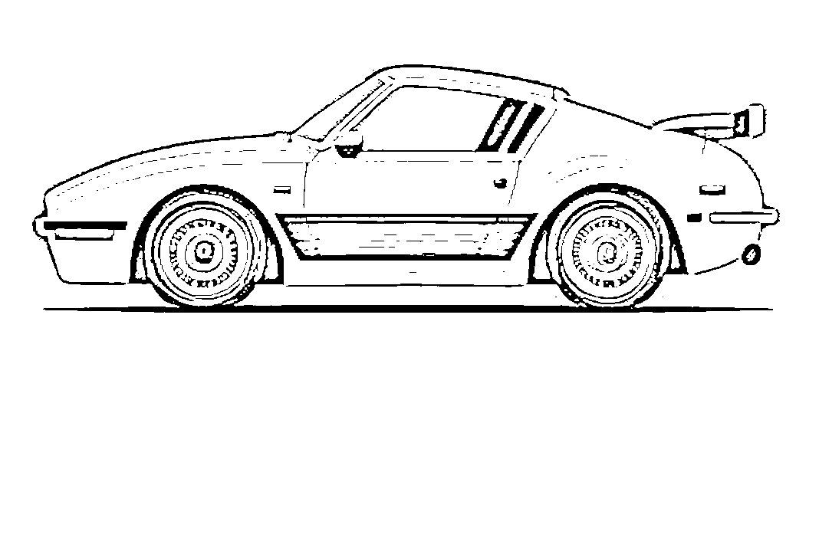
Trace & Color
Transportation
Car

Slide 4
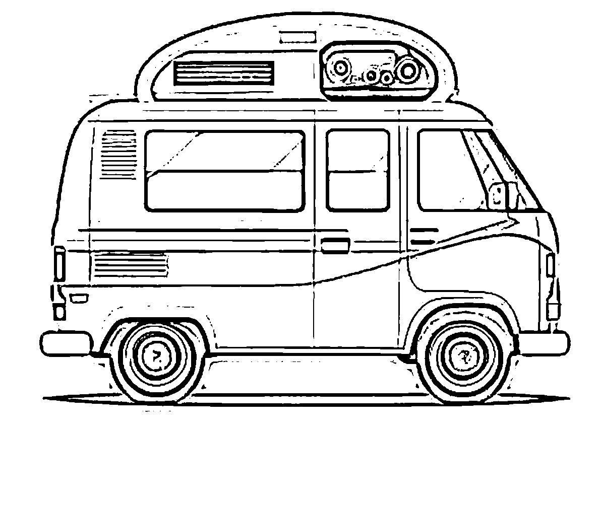

Trace & Color
Transportation
Van

Slide 5
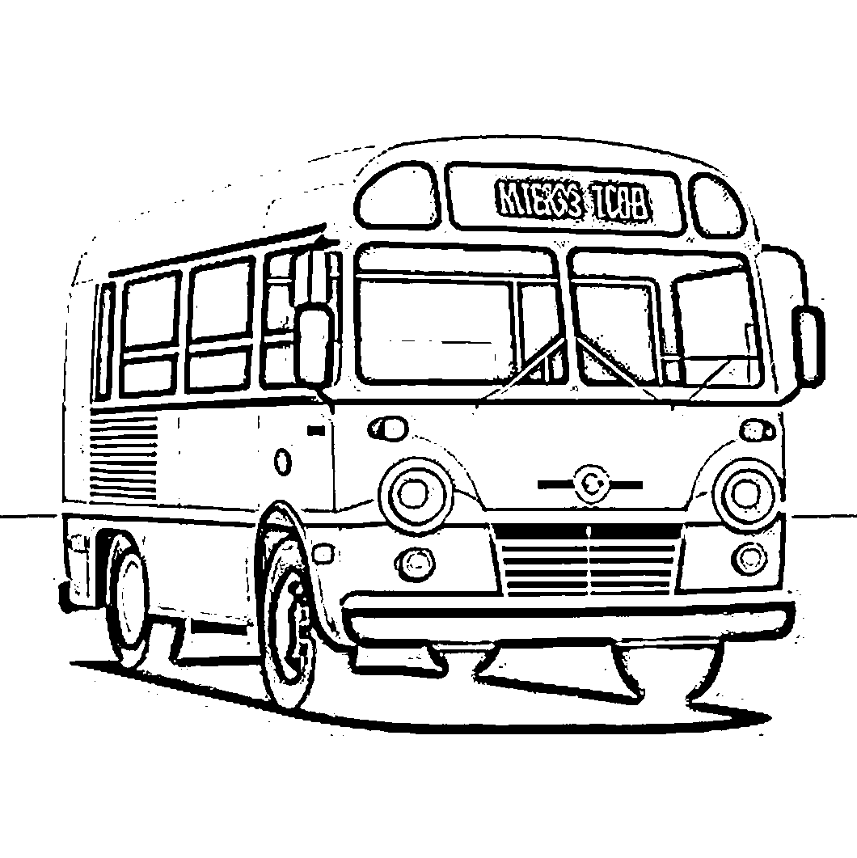

Trace & Color
Transportation
Bus

Slide 6
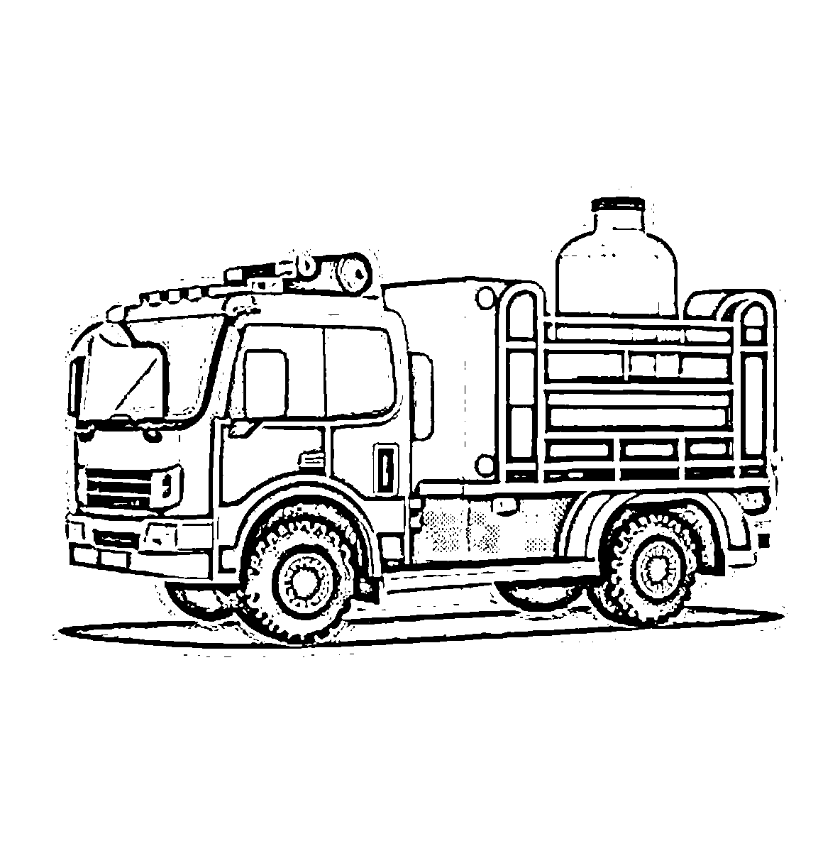

Trace & Color
Transportation
Firetruck

Slide 7
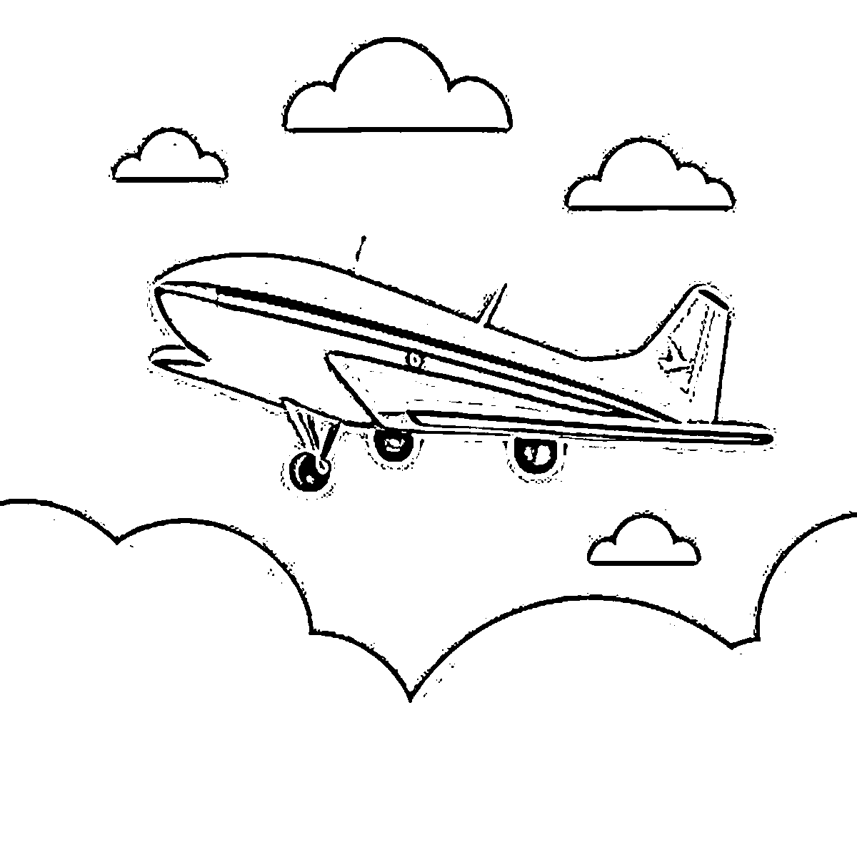

Trace & Color
Transportation
Airplane

Slide 8
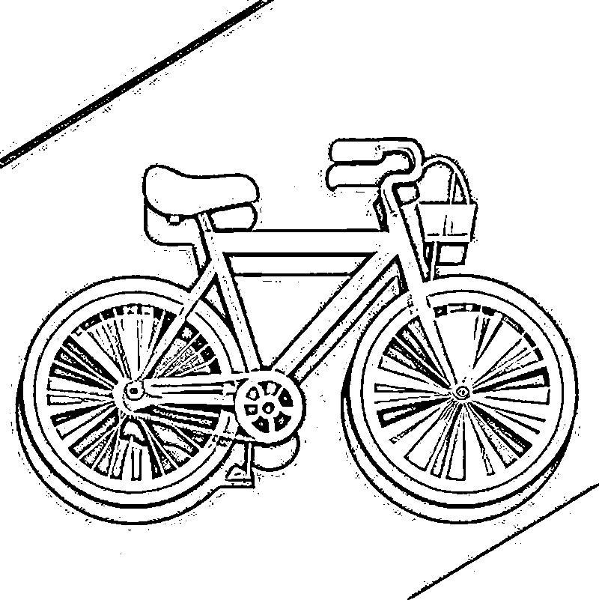

Trace & Color
Transportation
Bicycle

Slide 9
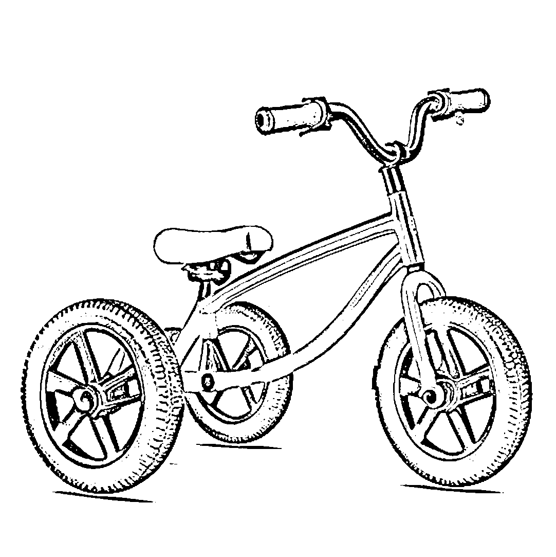
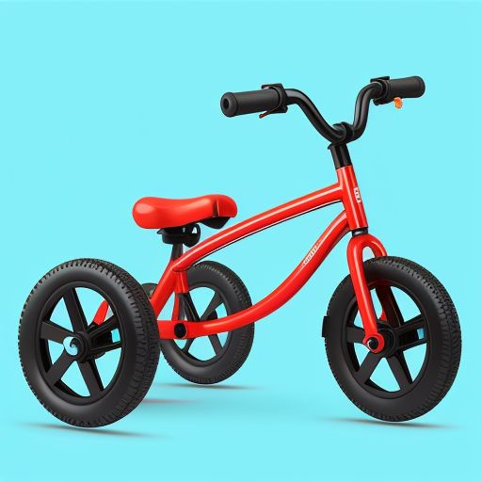
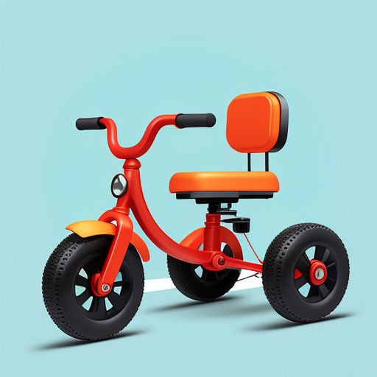
Trace & Color
Transportation
Tricycle

Slide 10
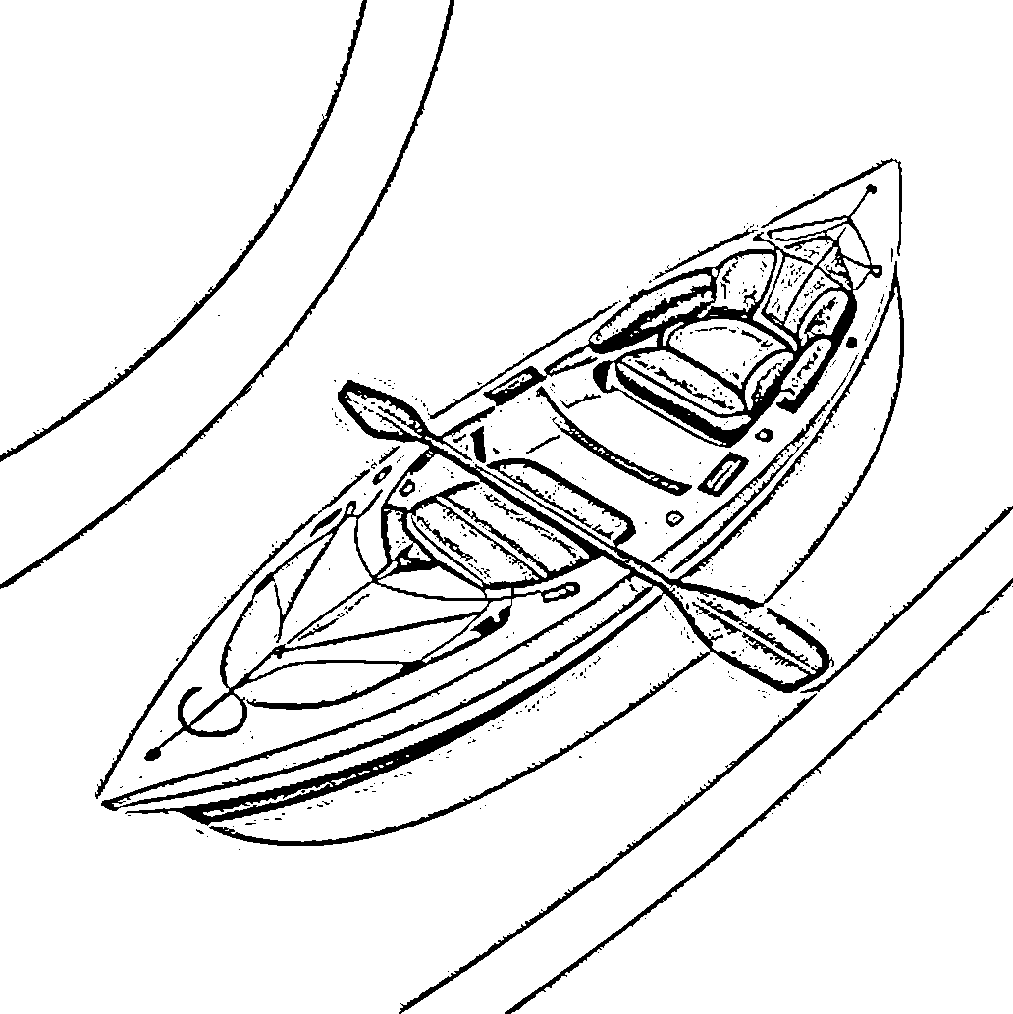



Trace & Color
Transportation
Kayak

Slide 11
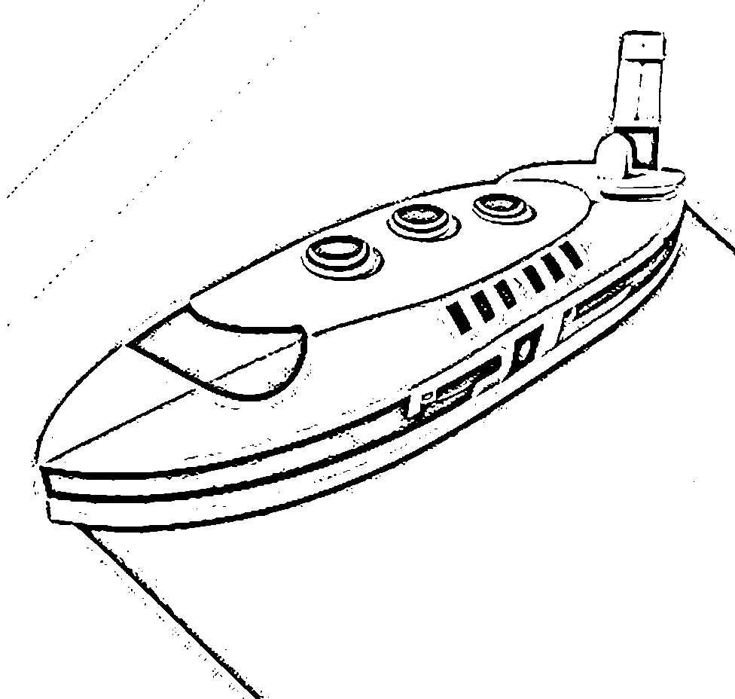


Trace & Color
Submarine
Transportation

Slide 12
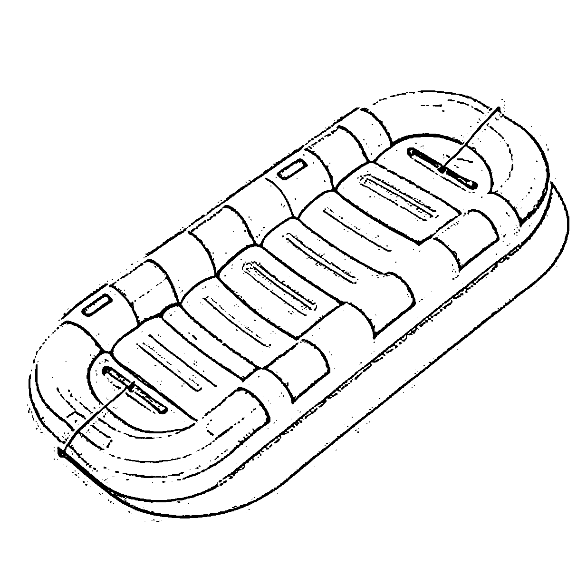

Trace & Color
Raft
Transportation

Slide 13
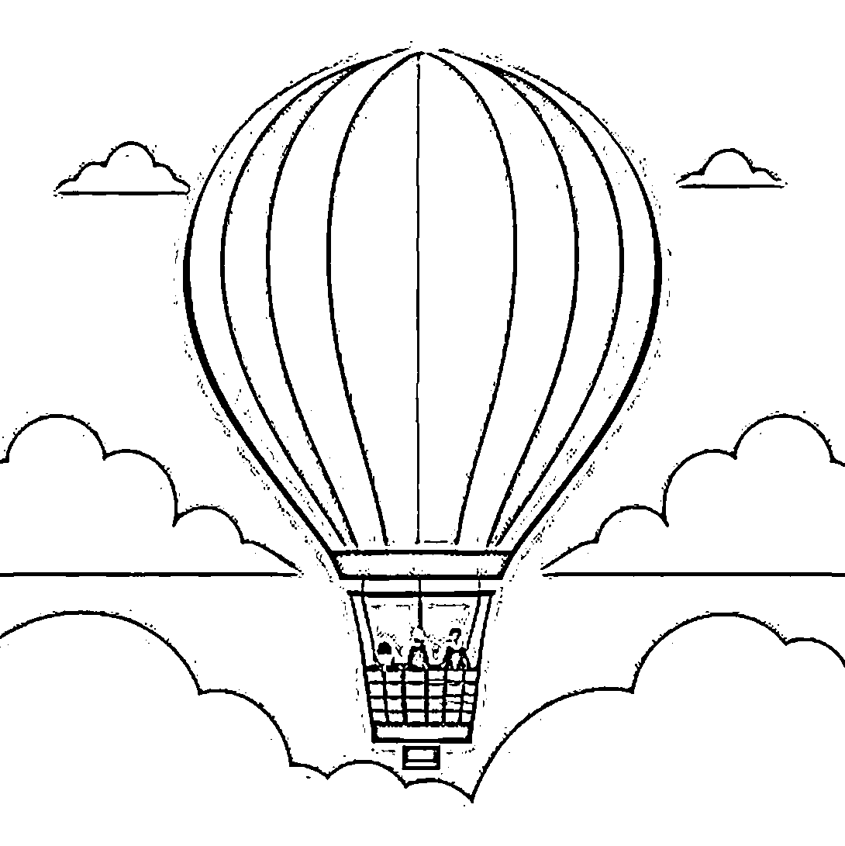

Trace & Color
Transportation
Hot air balloon

